Slide 1
Road Accident Detection using Deep Learning
Submitted in the partial fulfillment for the award of the degree of
BACHELOR OF ENGINEERING
IN
CSE (AIML)
Submitted by:
Ayush Mudgal 18BCS6124
Shubham Karnwal 18BCS6129
Himanshu Kunchal 18BCS6131
Shivam 18BCS6138
Hritik Johri 18BCS6145
Under the Supervision of:
GURPREET SINGH PANESAR
Department of AIT-CSE
DISCOVER . LEARN . EMPOWER

Slide 2
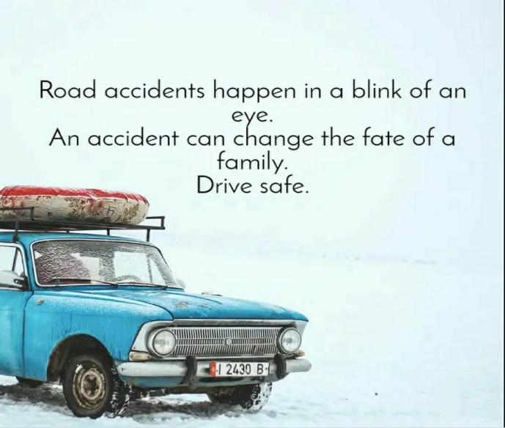
Outline
Introduction to Project
Problem Formulation
Objectives of the work
Methodology used
Results and Outputs
Conclusion
Future Scope
References

Slide 3
Introduction to Project:-
Car accidents cause a large number of deaths and disabilities every day, a certain proportion of which result from untimely treatment and secondary accidents. To some extent, automatic car accident detection can shorten response time of rescue agencies and vehicles around accidents to improve rescue efficiency and traffic safety level.
According to the World Health Organization, there are about 1.35 million deaths and 20-50 million injuries as a result of the car accident globally every year. Especially, a certain proportion of deaths and injuries are due to untimely treatment and secondary accidents, which results from that rescue agency and vehicles around accident cannot obtain quick response about the accident. Therefore, it is vital important to develop an efficient accident detection method, which can significantly reduce both the number of deaths and injuries as well as the impact and severity of accidents. Under this background, many fundamental projects and studies to develop efficient detection method have been launched for developing and testing.

Slide 4
Problem Formulation
Each video is a set of individual images that are time-dependent sequences. The algorithm - a hierarchical recurrent neural network - is able to treat each video as a time-dependent sequence, but still allow each video to be an independent data point.
The algorithm uses two layers of long short-term memory neural networks. The first neural network (NN) is a recurrent network that analyzes the time-dependent sequence of the images within each video. The second takes the encoding of the first NN and builds a second NN that reflects which videos contain accidents and which do not. The resulting model enables a prediction of whether new dashcam footage has an accident.
Through this method, the HRNN incorporates a time-dependent aspect of the frames within each video to predict how likely it is a new video contains a car accident.

Slide 5
Objectives
We will use the CADP dataset for videos containing accidents and the DETRAC dataset which is originally made for object detection of vehicles, as the videos does not contain accidents. To expand our dataset we will also search the internet for videos containing cases of accidents. For the final dataset, we plan to have 150-200 videos with car, bus, bike etc. accidents recorded in the CCTV camera at the corners of the street. We will take the same number of negative cases(without accident) to maintain balanced classes . Each video will be broken up into its individual frames to be analyzed separately. Each of these images is a two-dimensional array of pixels where each pixel has information about the red, green, and blue (RGB) color levels. To reduce the dimensionality at the individual image level, we will convert the 3-D RGB color arrays to grayscale. Additionally, to make the computations more tractable on a CPU, we will resize each image to (144, 256) - in effect reducing the size of each image to a 2-D array of 144x256.We are planning to use a hierarchical recurrent neural network(RNN) algorithm to tackle the complex problem of classifying video footage.

Slide 6
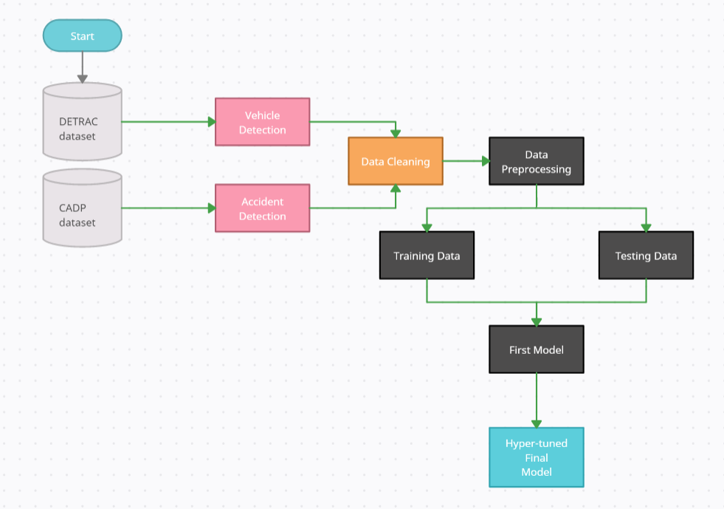

Slide 7
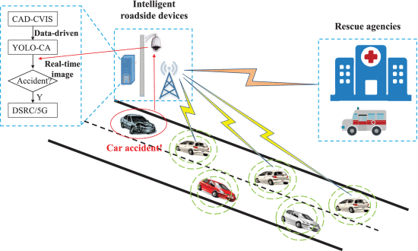

Slide 8
Methodology
The Data:
We will use the CADP dataset for videos containing accidents and the DETRAC dataset which was originally for object detection of vehicles. To expand our dataset we will also have to downloaded YouTube videos that contain accident. Over 380 videos were collected from the above mentioned sources.
Training Dataset:
For the final dataset, we are expecting to have 1500 videos with car, bus, bike etc. accidents recorded in the CCTV camera at the corners of the street. We are expecting to have the same number of negative cases(without accident) as positive cases to maintain balanced classes.
Processing:
Each video is broken up into its individual frames to be analyzed separately. Each of these images is a two-dimensional array of pixels where each pixel has information about the red, green, and blue (RGB) color levels. To reduce the dimensionality at the individual image level, we convert the 3-D RGB color arrays to grayscale. Additionally, to make the computations more tractable on a CPU, we will resize each image to (144, 256) - in effect reducing the size of each image to a 2-D array of 144x256.
The Algorithm:
A hierarchical recurrent neural network algorithm is used to tackle the complex problem of classifying video footage.

Slide 9
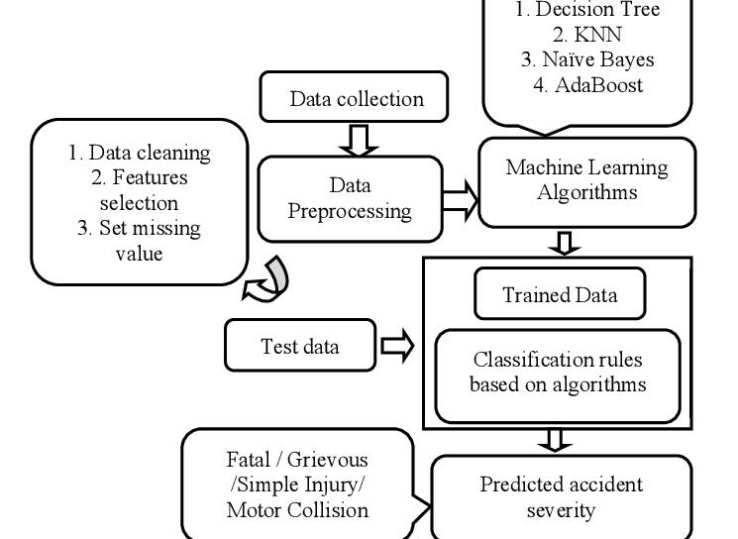

Slide 10
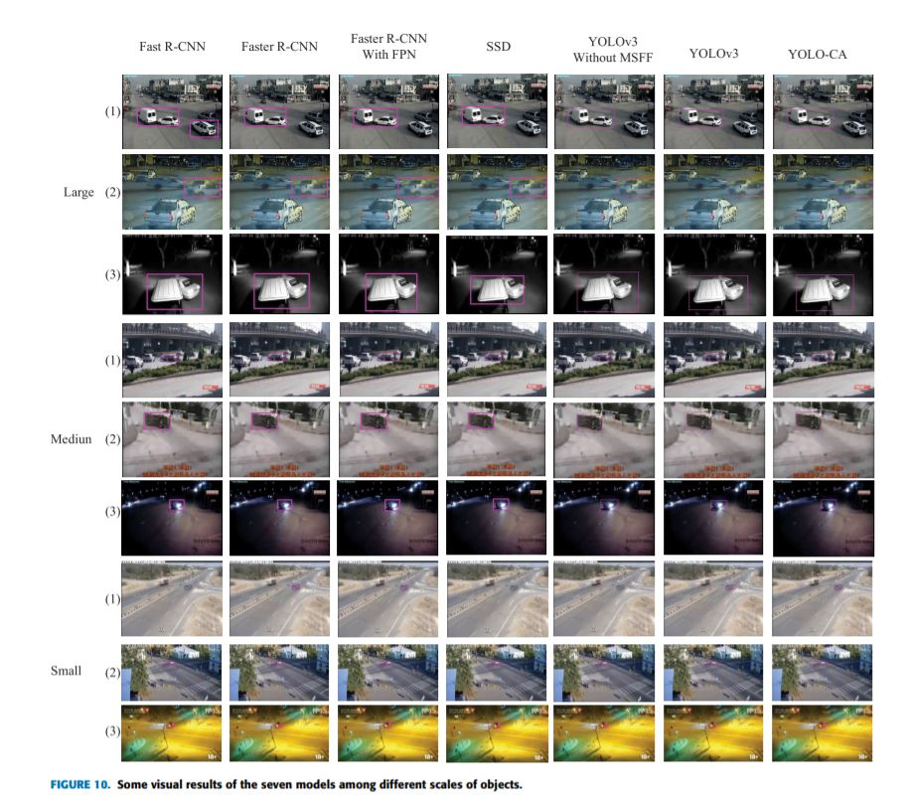
Results and Outputs

Slide 11
Conclusion
In this, we will propose an accident detection method based on deep learning. First of all, hierarchical recurrent neural network algorithm model has been deployed to detect accidents in never-before-seen videos. Secondly, we build a CADP dataset , which is more suitable for car accident detection.

Slide 12
Future Scope
Vehicle mishaps are increasing day by day. Therefore, itbecomes extremely important to find a way to reduce it.From this paper it can be observed that such a system canspare numerous lives. As of now, the system is using thelocation based on Coordinates where the camera is located and employing an alert message bythe Smtplib module. This system can be expanded in thefuture by integrating it with Google Maps. Another upgradation could be in the message sending module. Apartfrom sending the message to the registered Email only,an alert message would likewise be sent to the nearbyavailable ambulance or the hospitals.

Slide 13
References
Nicky Kattukkaran, Arun George, Mithun Haridas, INDIA Intelligent Accident Detection and Alert System for Emergency Medical Assistance
[2] Zainab Salim Alwan, Hamid M. Ali Alshaibani, Car Accident Detection and Notification System Using Smartphone [
3] Vardhini Radhakrishnan, Smart Vehicle Accident Detection System
[4] Murat Ozbayoglu, Gokhan Kucukayan, Erdogan Dogdu A Real-Time Autonomous Highway Accident Detection Model Based on Big Data Processing and Computational Intelligence
[5] https://www.who.int/news-room/fact-sheets/detail/road-traffic-injuries
[6] https://medium.com/@rjm2017/vehicle-detection-options-and-recommendations-b44 7fddccc22
[7] https://medium.com/@iceberg12/vehicle-detection-and-tracking-f607bbf860dd

